Slide 1






AIRLINES SAFETY ANALYSIS
Naveen Bagam

Slide 2
Airline Safety Analysis: Separating Fact from Fiction
Introduction:
Airline safety concerns in the media
Claims of increasing danger compared to automobiles

Slide 3
Objective:
Analyze airline crash and fatality data
Compare data from 1985-1999 and post-2000 era
Determine trends and patterns in airline safety

Slide 4
Data Collection:
Gathered data from reputable sources
Focused on 1985-1999 and post-2000 periods
Ensured data reliability and availability

Slide 5
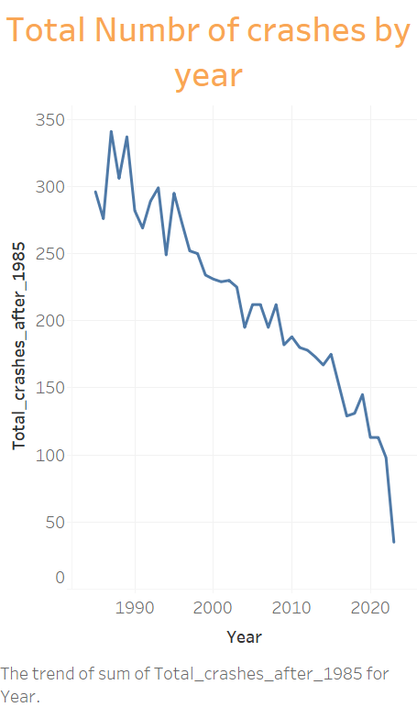
Visualizations:

Slide 6
Visualizations: From the line chart above, sourced from https://www.baaa-acro.com/statistics, we can observe a gradual reduction in the number of crashes from 1995 to 2022. This indicates an improvement in airline safety over time.

Slide 7
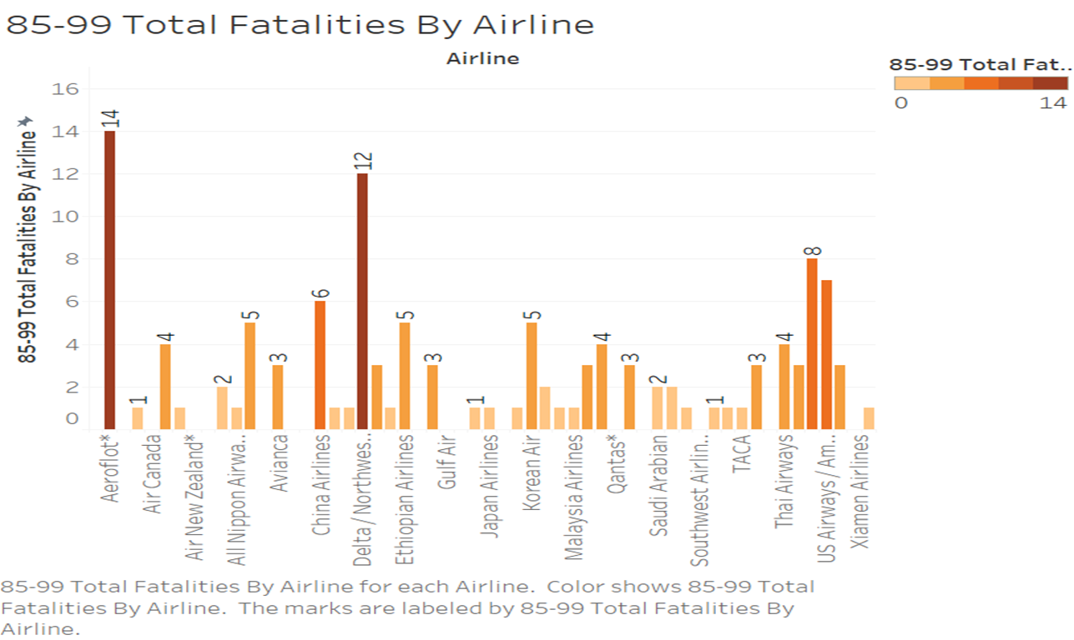
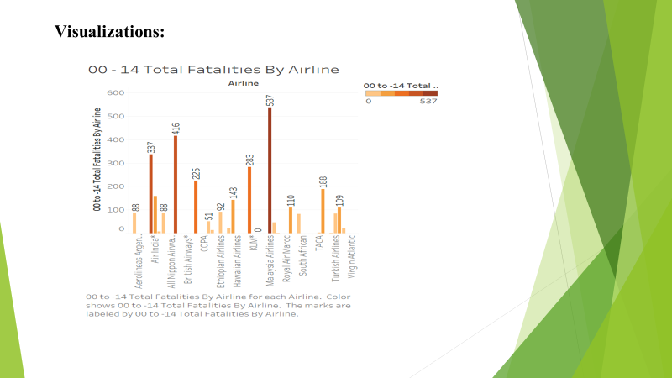
Airline Fatalities between 1985-1999
Airline Fatalities between 2000-2014

Slide 8
From the Bar chart above, we can observe that during the period from 1985 to 1999, the number of fatalities per airline is relatively lower. This can be attributed to the lower frequency of flights, fewer miles flown, and a smaller number of people flown during that time.
Also, from the period of 2000-2014 bar chart we can understand that there are certain airlines with a higher number of fatalities, indicating poor safety standards maintained by those airlines. Additionally, it is important to consider that the frequency of flights and the number of people flown have gradually increased over time. This increased in air travel activity has had an impact on the fatality rate from 2000 to the present day.

Slide 9
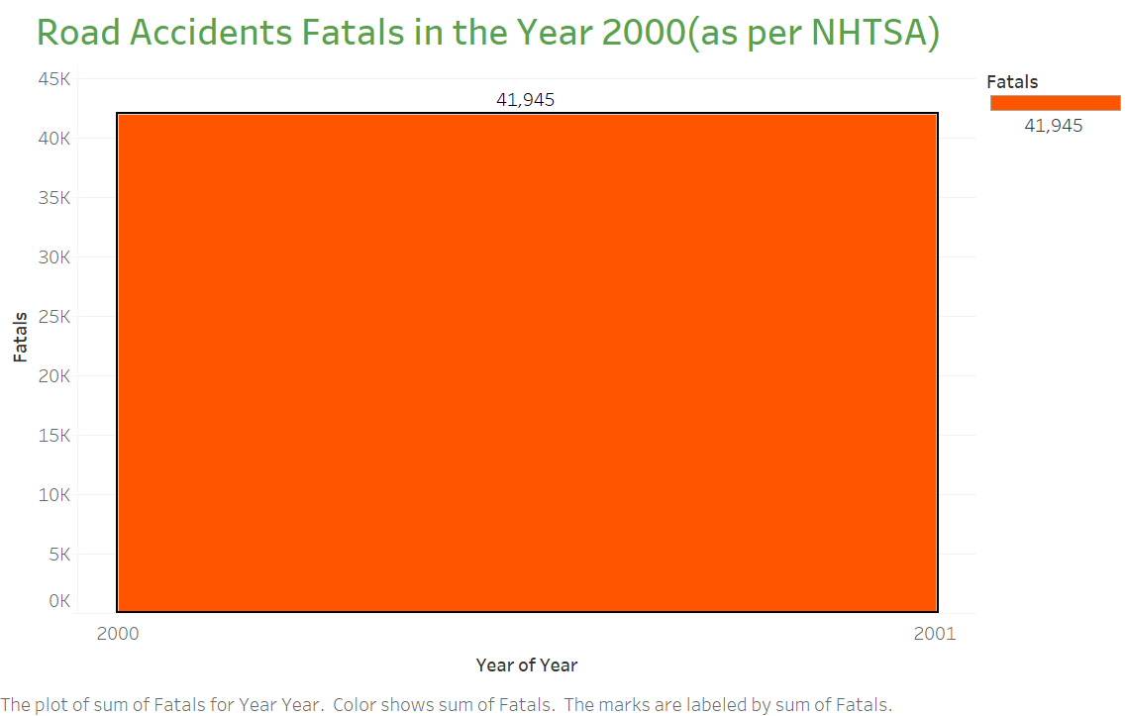
Visualizations:

Slide 10
Visualizations: From the above visualization, we can observe that in the year 2000, there were 41,945 fatalities due to road accidents. This highlights the fact that fatalities can occur in any mode of transportation, including road travel. It is important to recognize that safety risks exist across different transportation modes and to implement appropriate measures to ensure the safety of travelers in all forms of transportation.

Slide 11
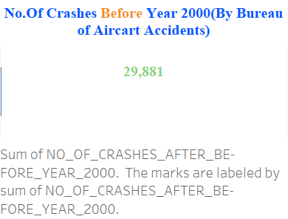
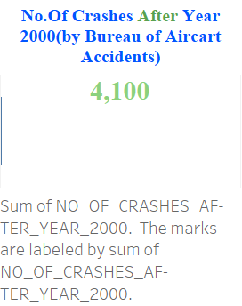
Visualizations:

Slide 12
Visualizations: From the above metrics visualization, we can observe that the number of crashes has decreased from the period of 1985-1999 to 2000-2014. This indicates that measures taken to improve airline safety and enhance aircraft quality have had a positive impact. The reduction in crashes suggests that advancements in safety protocols, technology, and industry regulations have contributed to making air travel safer. It is important to continue prioritizing and investing in airline safety measures to ensure the well-being and confidence of passengers.

Slide 13
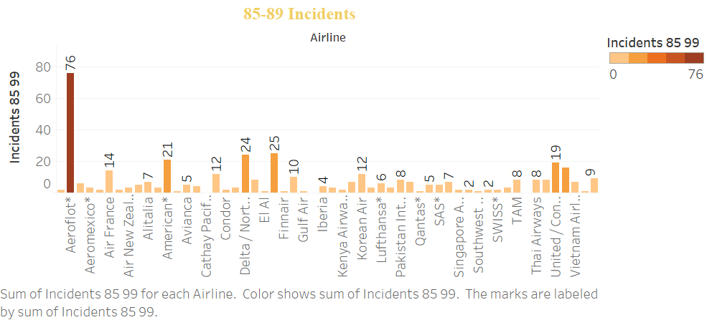
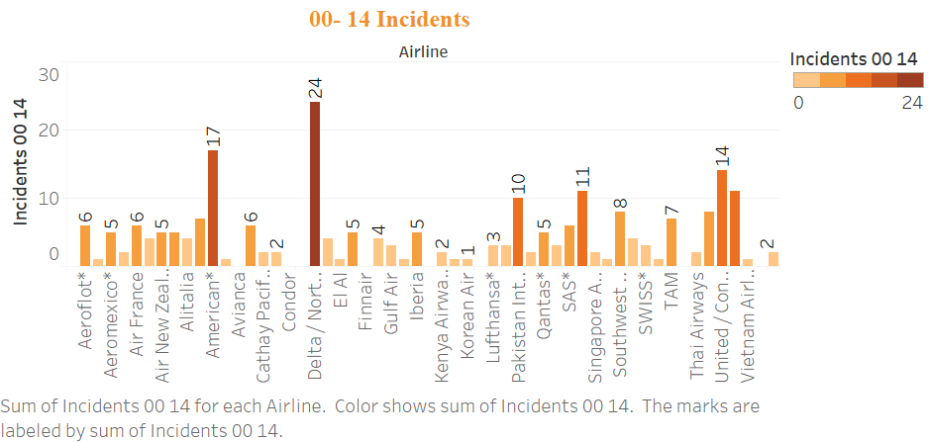
Airline Incident between 1985-1989
Airline Incident between 2000-2014

Slide 14
Visualizations: The two visualizations provided above represent the number of incidents during two distinct periods: 1985-1999 and 2000-2014. These visualizations serve as a reference to understand which airlines experienced a higher number of incidents within these timeframes. By examining the data displayed in these visualizations, we can gain insights into the relative safety records of different airlines and identify any notable patterns or trends. This information can be useful for assessing the performance and safety standards of individual airlines and informing decision-making processes related to air travel.

Slide 15
Ethical Considerations:
Privacy and sensitivity of data respected, used solely for research purposes.
Transparency and accuracy in reporting the findings to promote trustworthiness.
Clear communication of the limitations and scope of the analysis.

Slide 16
Conclusion:
:
Airline safety has improved over time
Media claims not entirely supported by data
Airlines continue to prioritize passenger safety

Slide 17
Sources
https://github.com/fivethirtyeight/data/tree/master/airline-safety
https://www.nhtsa.gov/nhtsa-datasets-and-apis
https://www.baaa-acro.com/statistics

Slide 18
Thank You!

